Slide 1
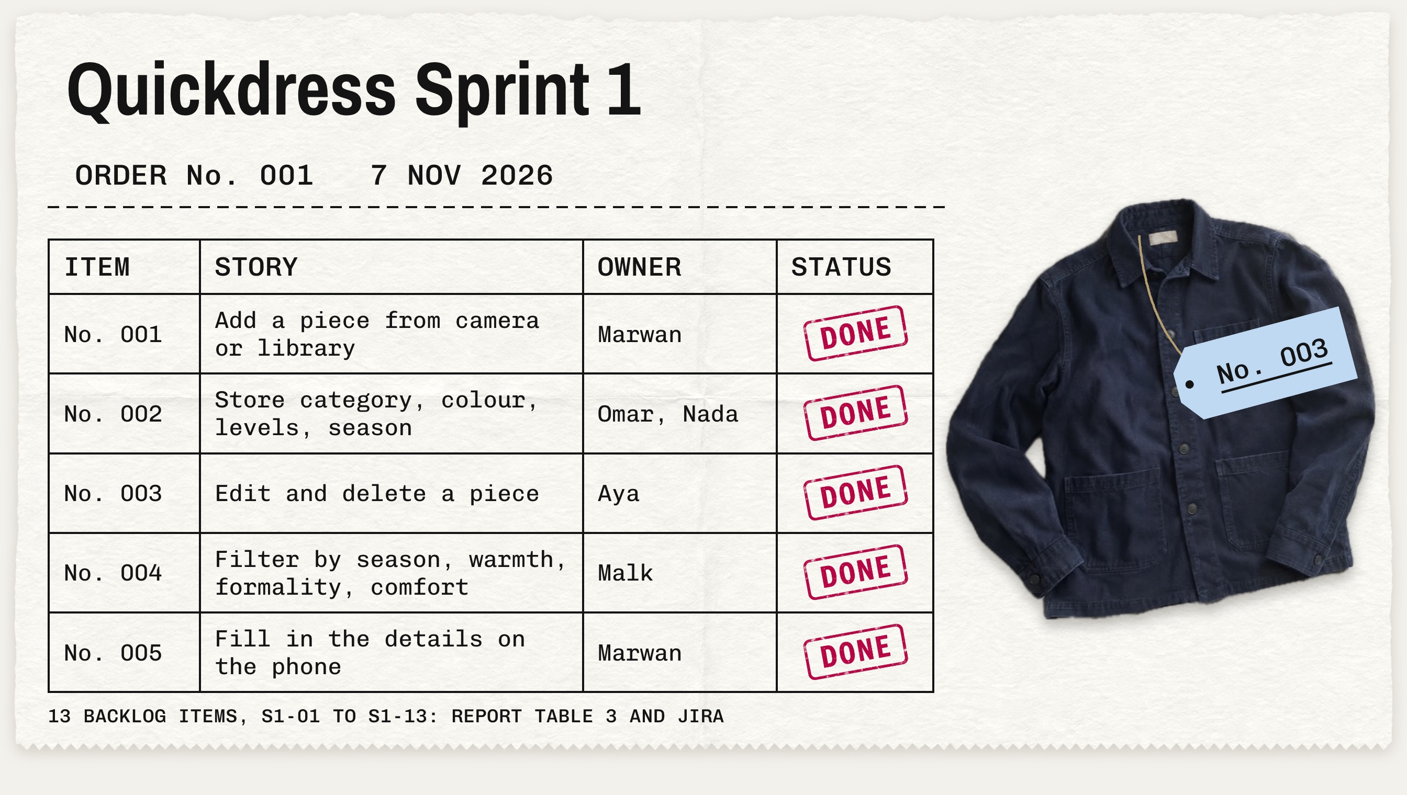
Notes:
Sprint 1 as one order. Five stories, each with its owner, all done. The shirt is a real photo our own code cut out.

Slide 2
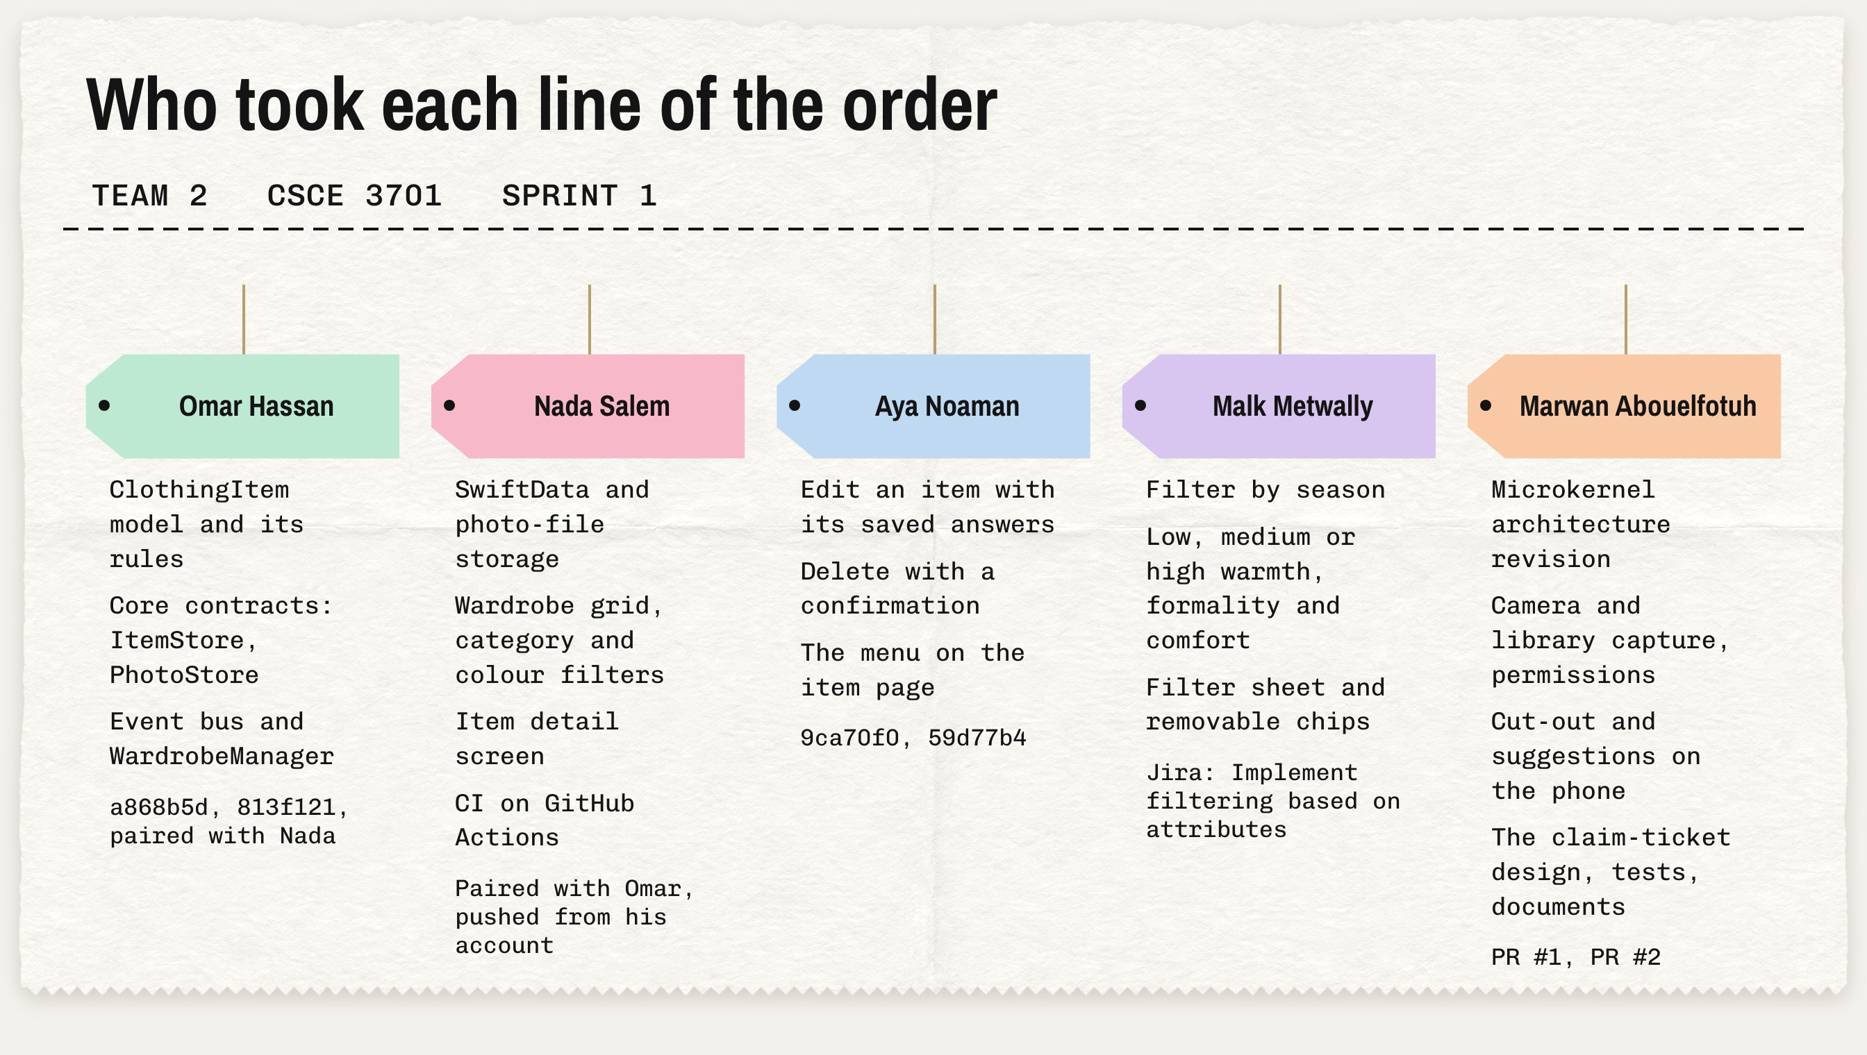
Notes:
Each member owned one part. Omar built the core model and contracts, Nada the storage, grid and CI; they paired, so both are under Omar's commits.

Slide 3
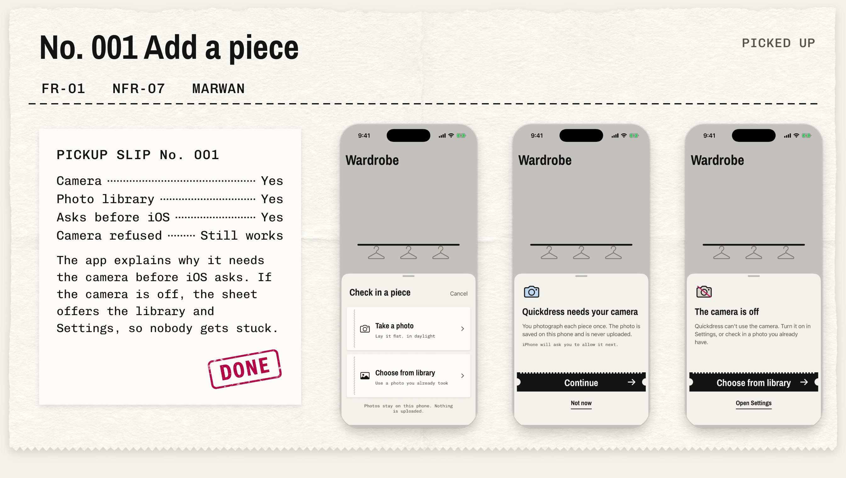
Notes:
Adding a piece: camera or library. The app explains the camera before iOS asks, and still works if the camera is refused.

Slide 4
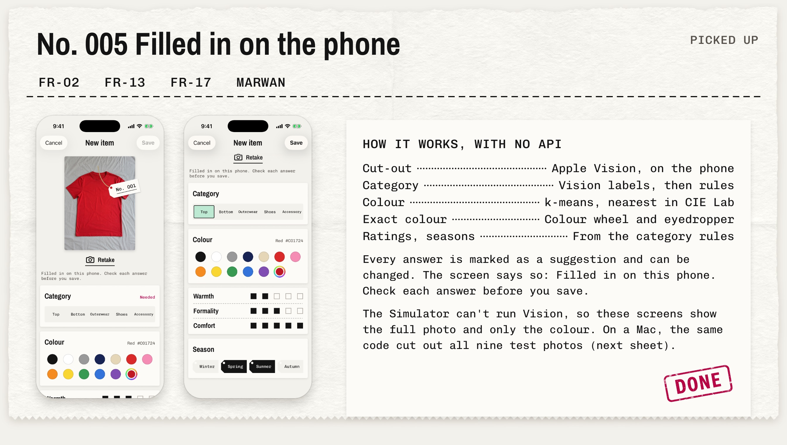
Notes:
The New item screen fills in category, colour, ratings and seasons on the phone, with no API. Every answer can be changed.

Slide 5
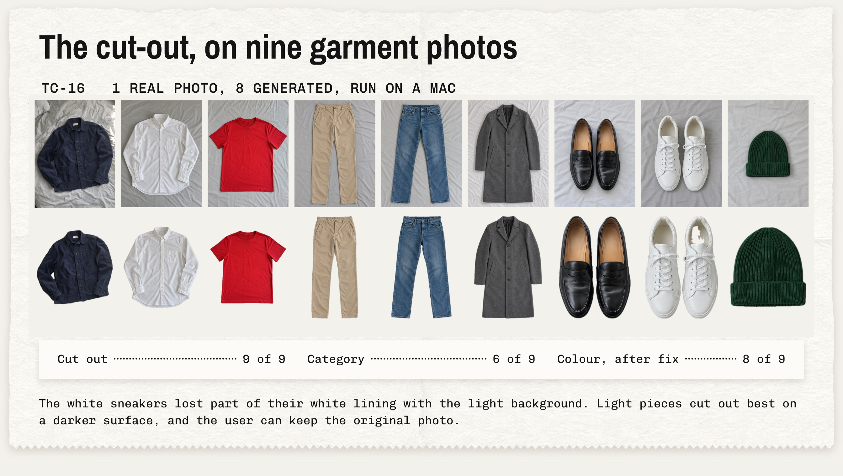
Notes:
We ran the app's own cut-out code on nine photos on a Mac, because the Simulator has no Vision. 9 of 9 cut out.

Slide 6
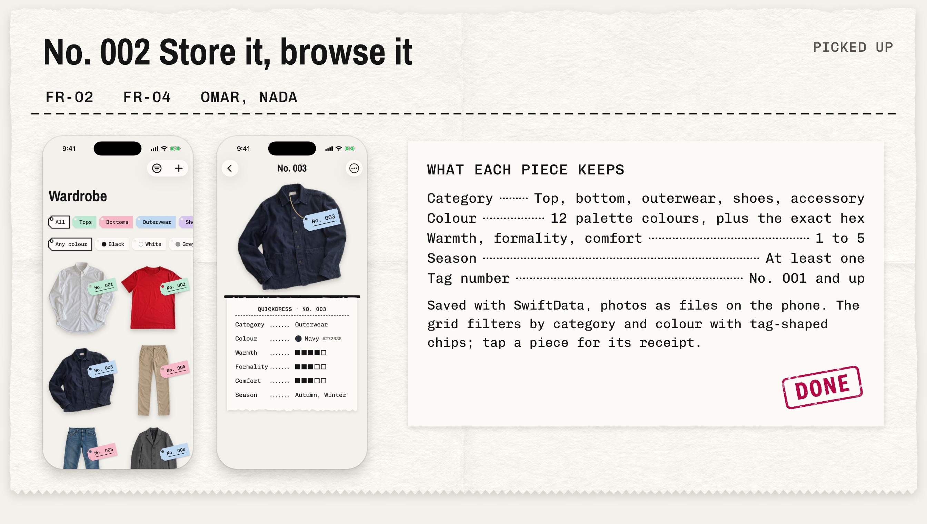
Notes:
Each piece keeps its category, colour, three ratings, seasons and tag number. The grid filters by category and colour.

Slide 7
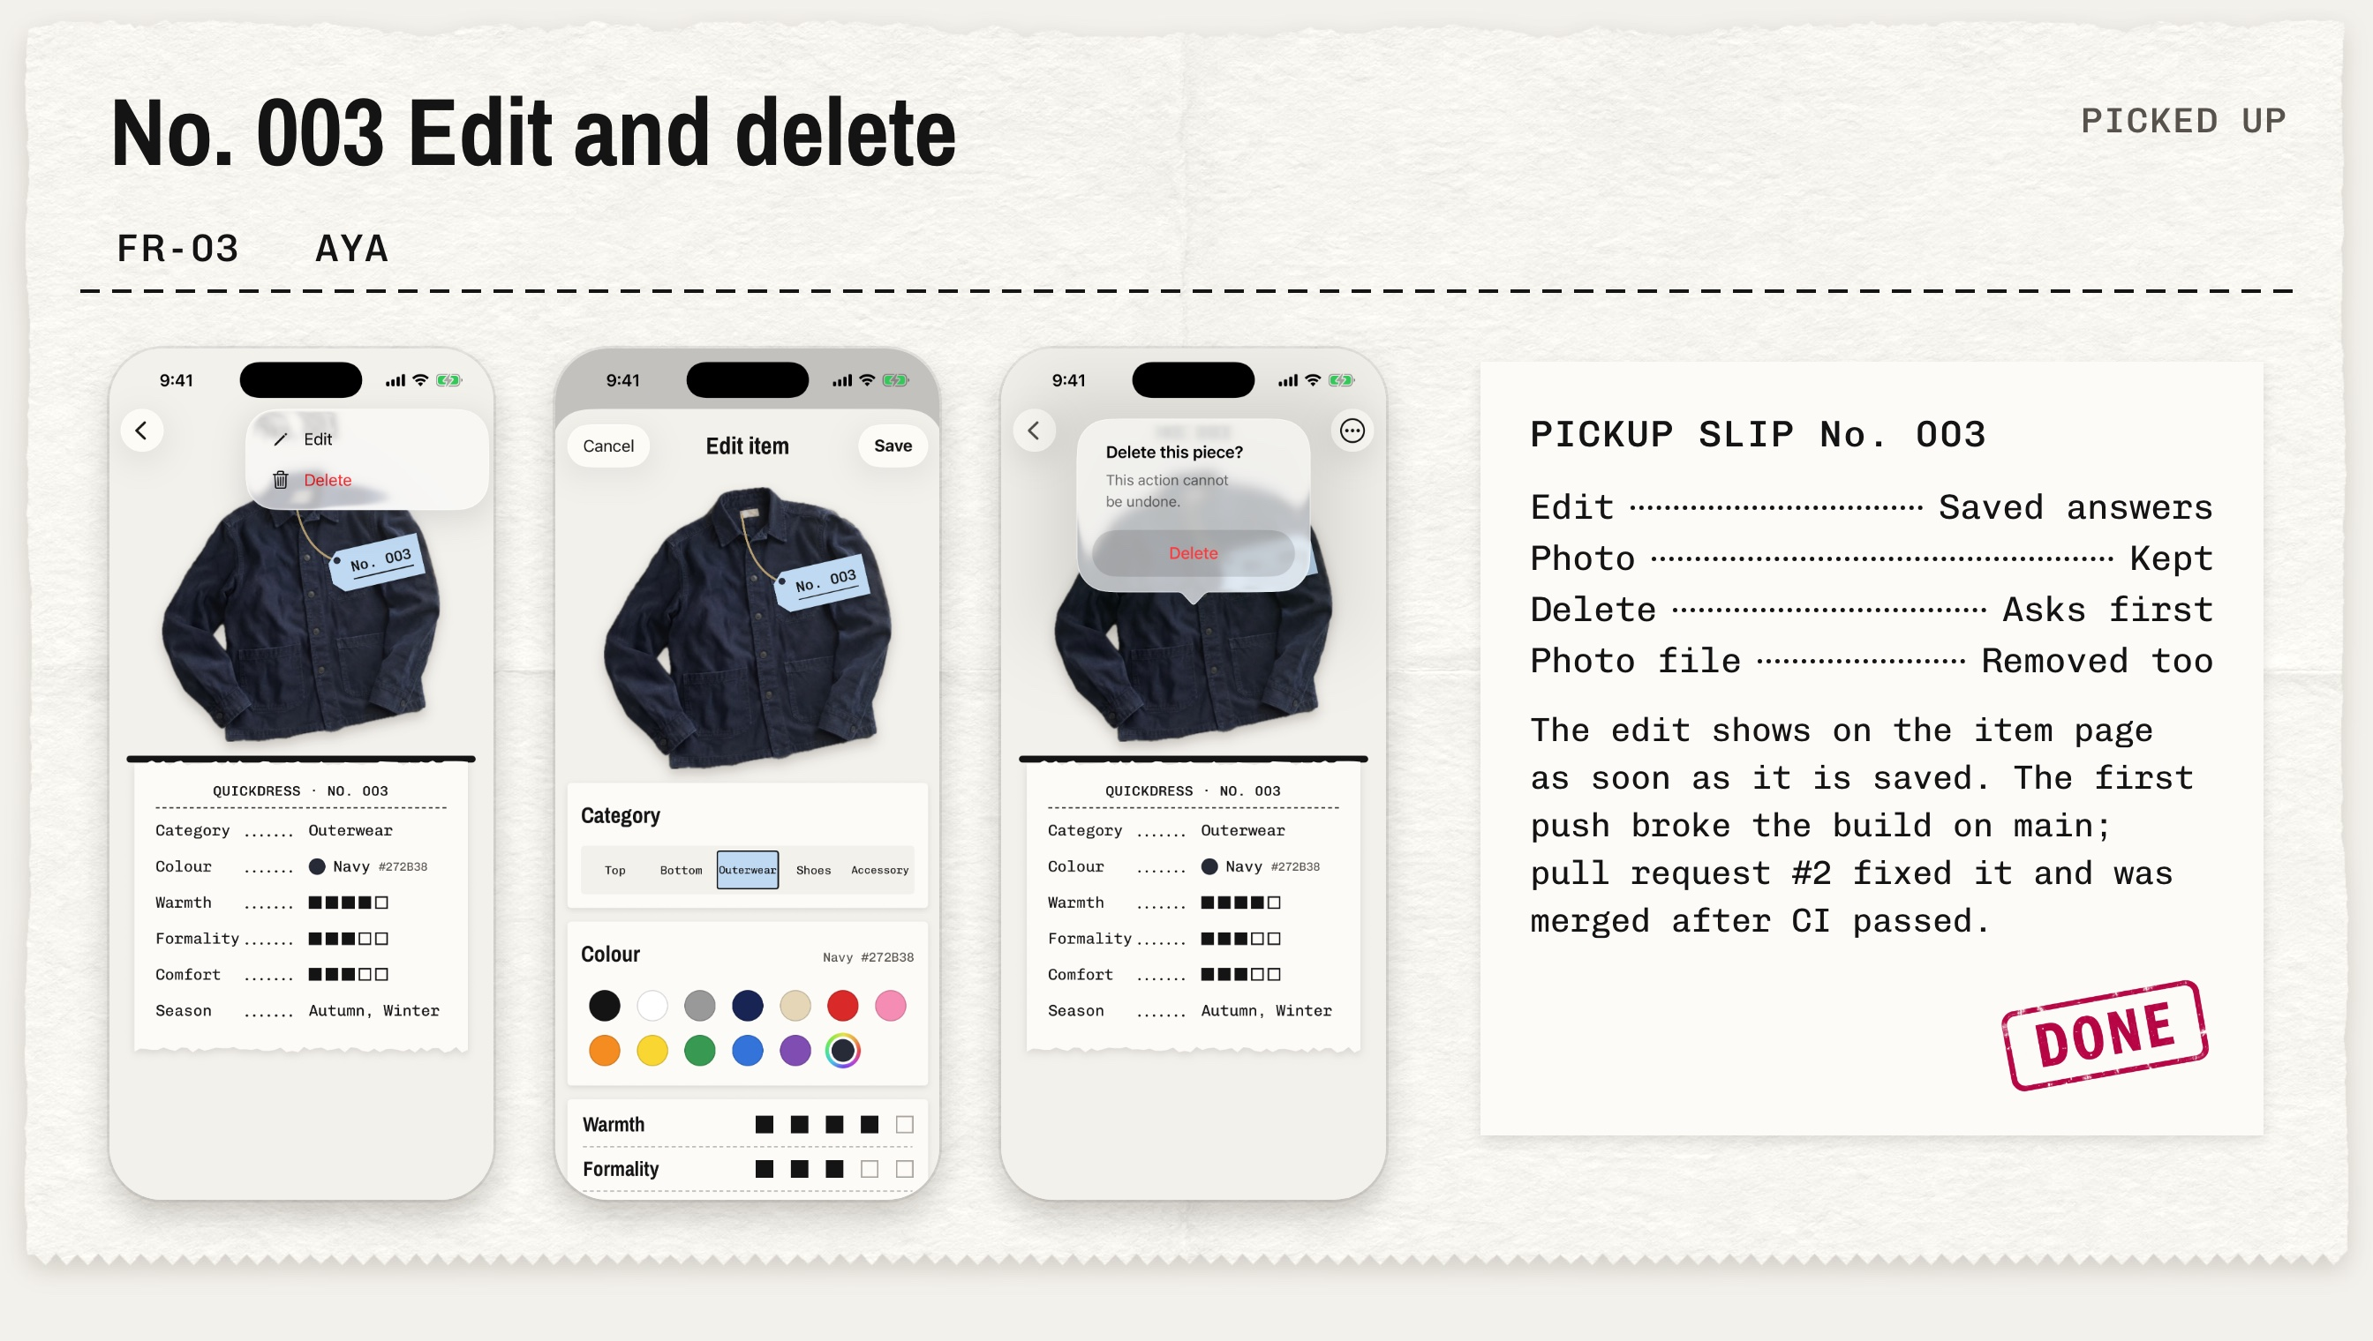
Notes:
Aya's edit and delete. The first push broke the build on main; pull request 2 fixed it the same day.

Slide 8
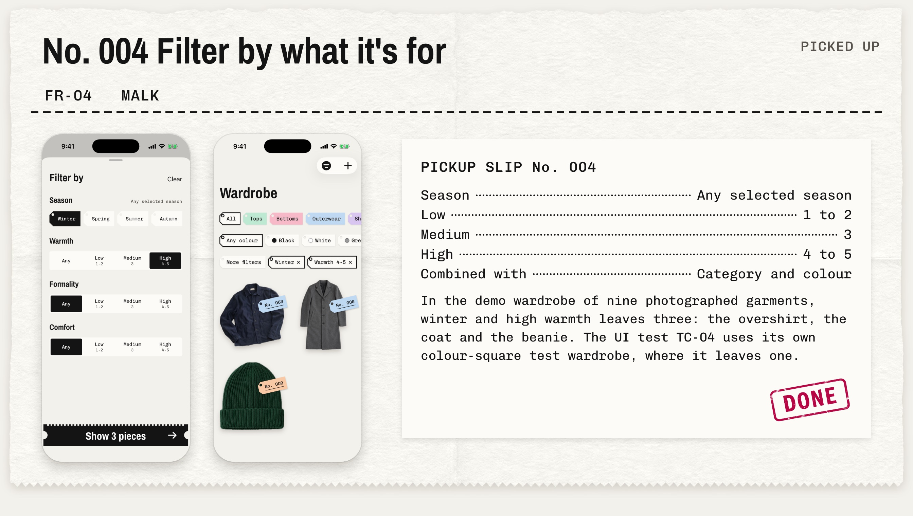
Notes:
Malk's filters: season, and low, medium or high warmth, formality and comfort. Winter plus high warmth leaves three pieces.

Slide 9
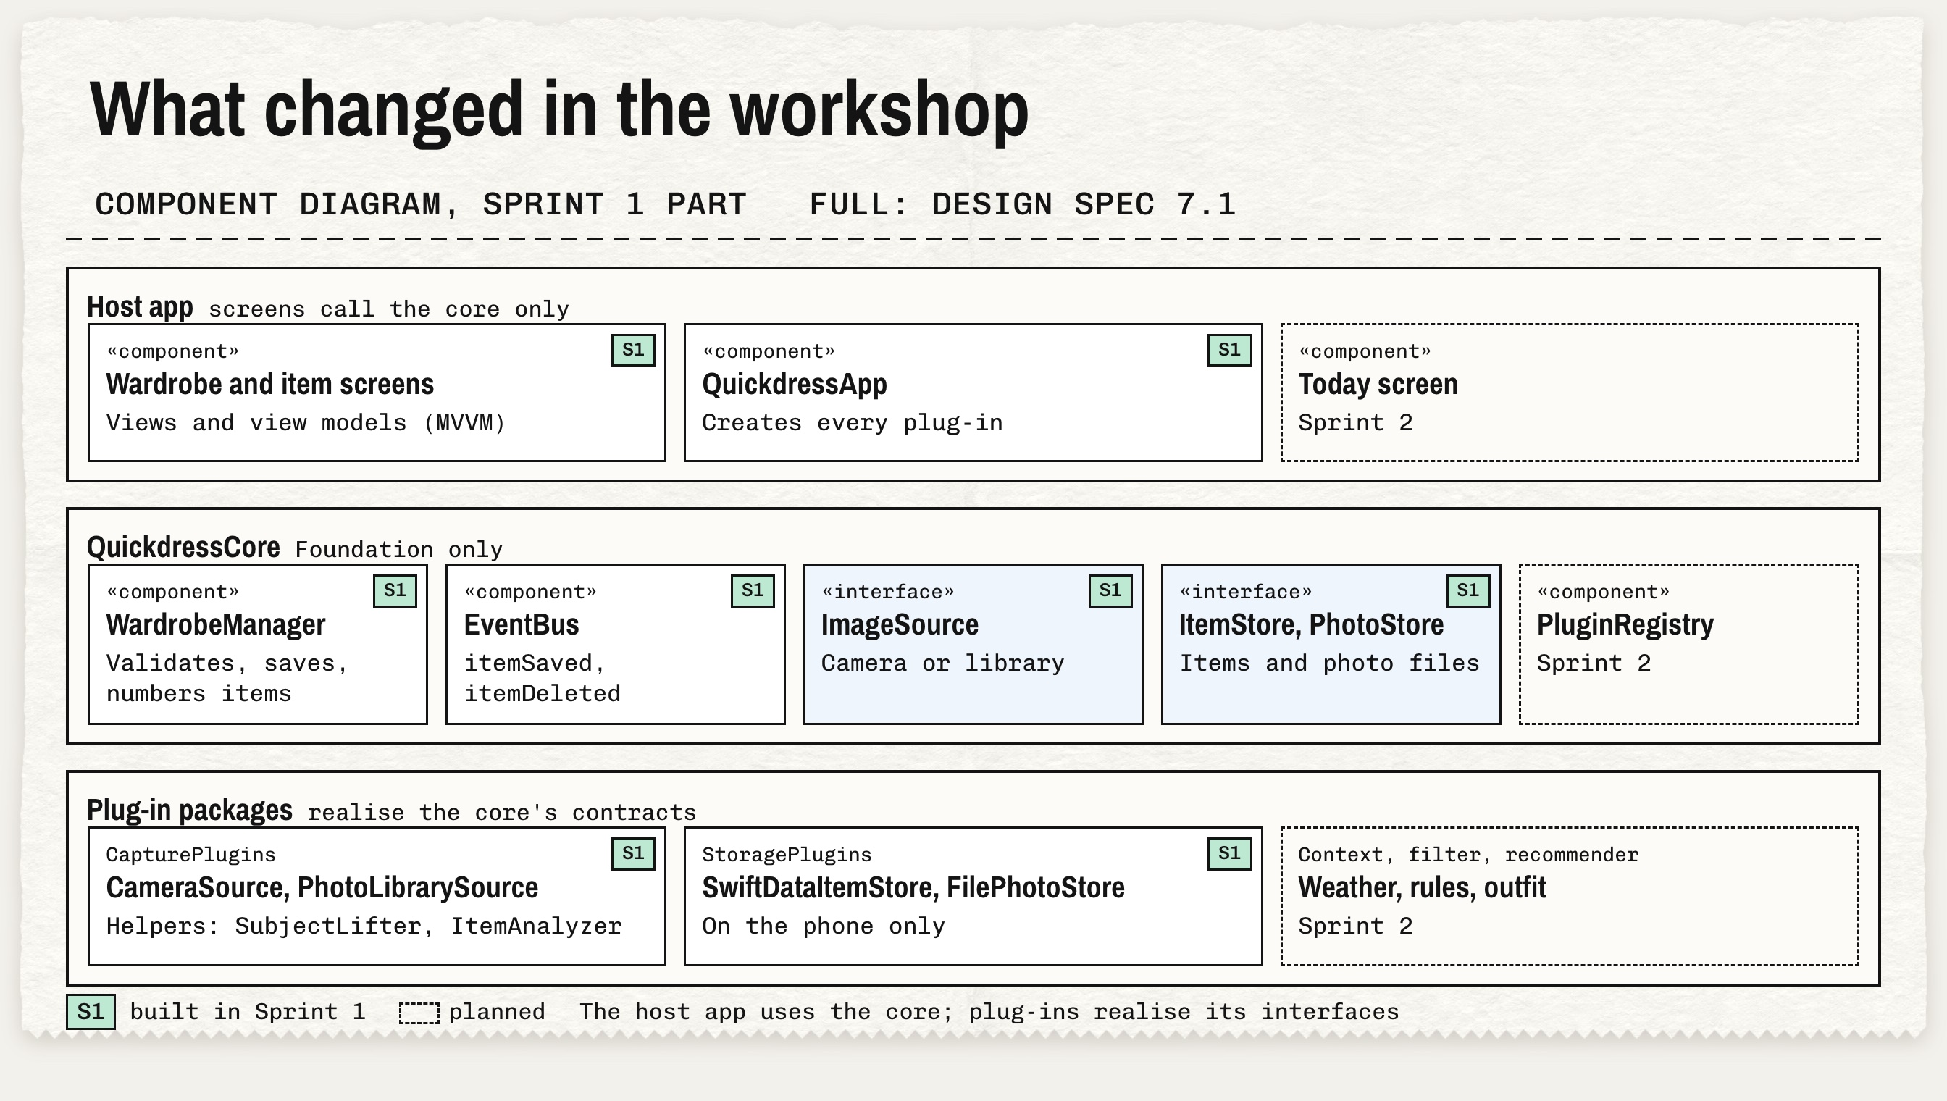
Notes:
The microkernel from the revised Milestone 1 held. New: the ImageSource contract, two capture helpers, and domain changes. The registry moves to Sprint 2.

Slide 10
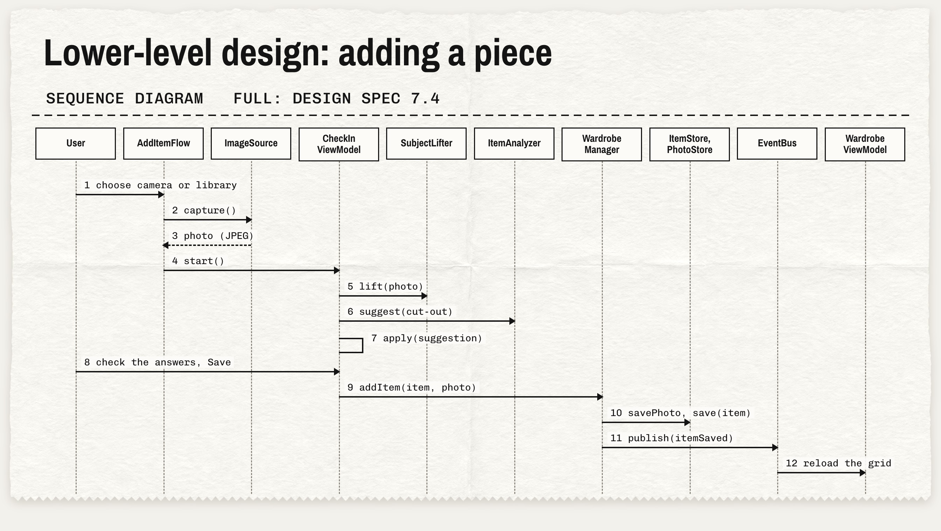
Notes:
Adding a piece, step by step, from the image source to the event that refreshes the grid.

Slide 11
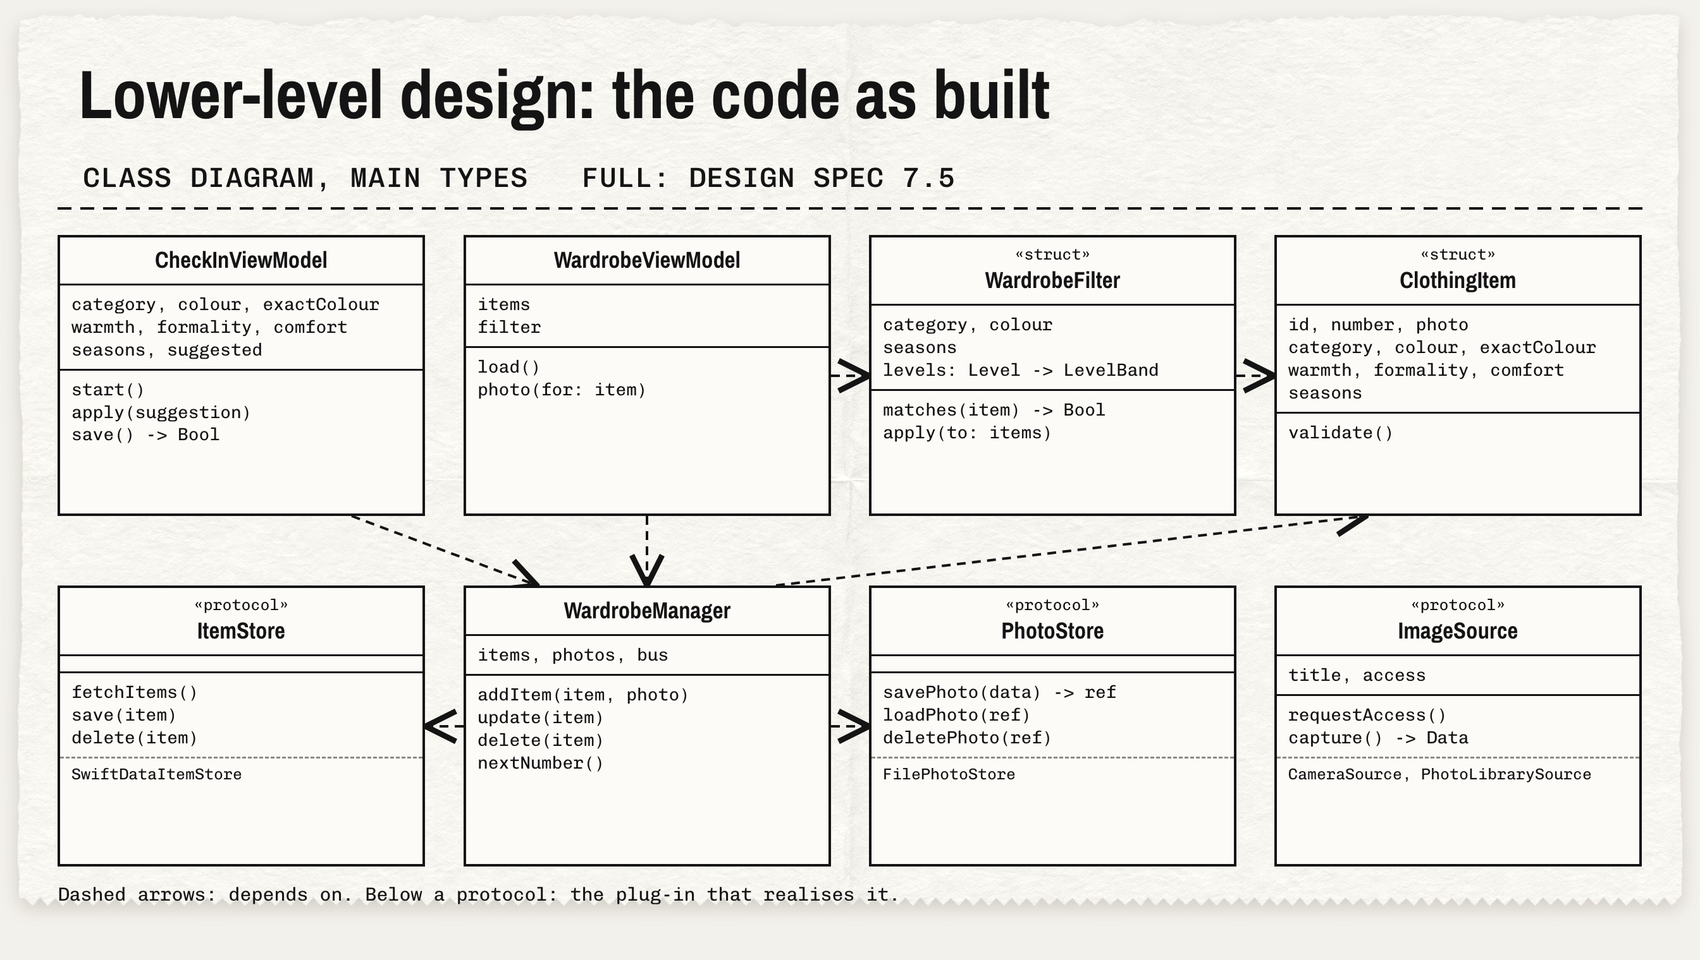
Notes:
The class diagram of the code as it is now. MVVM screens on top, the core in the middle, plug-ins behind contracts.

Slide 12
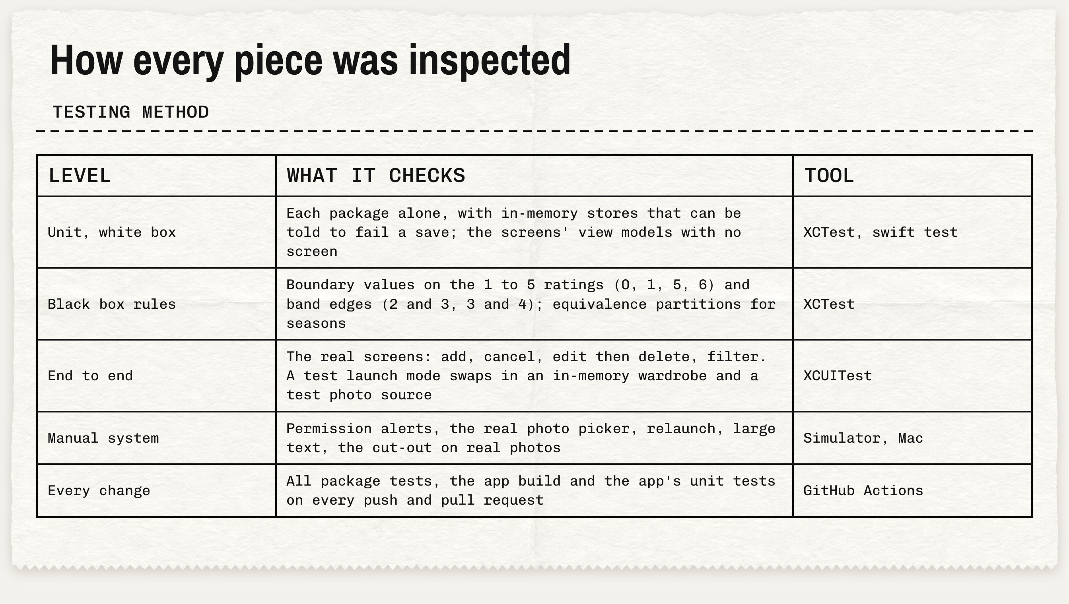
Notes:
Five levels of testing, from unit tests with test doubles to CI on every push and pull request.

Slide 13
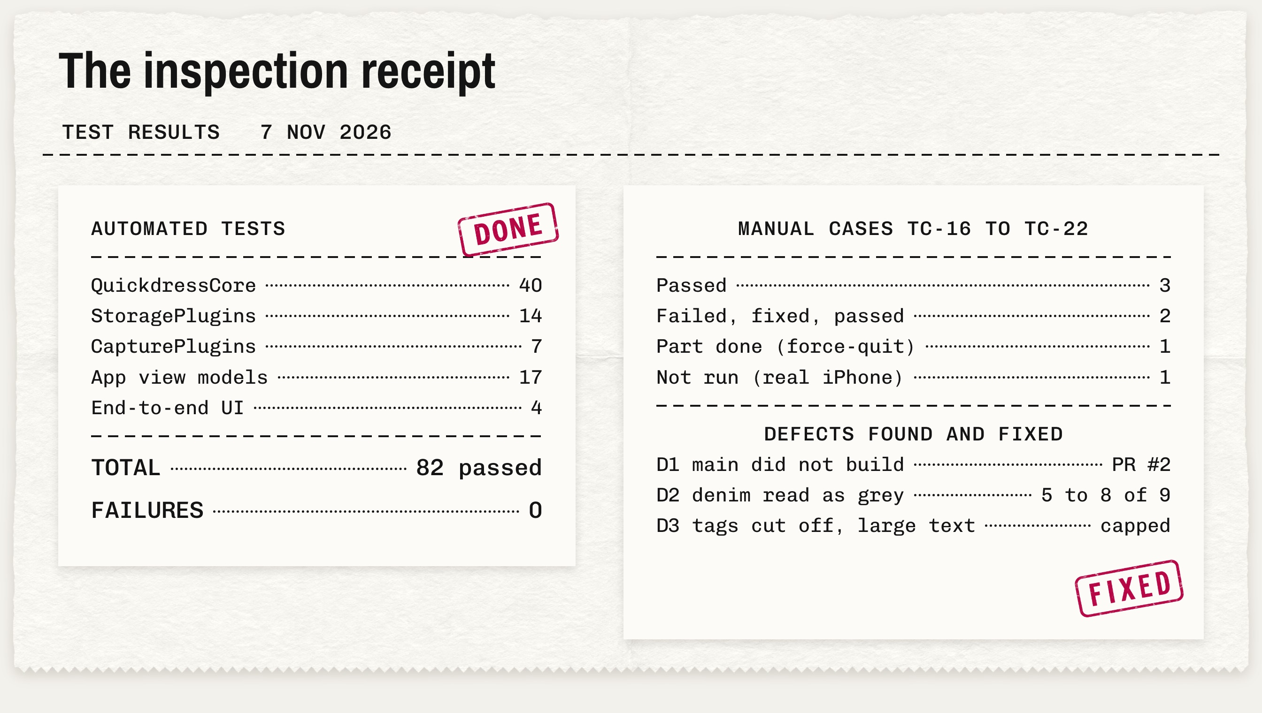
Notes:
82 automated tests, 0 failures. Seven manual cases. Three defects found and fixed during the sprint.

Slide 14
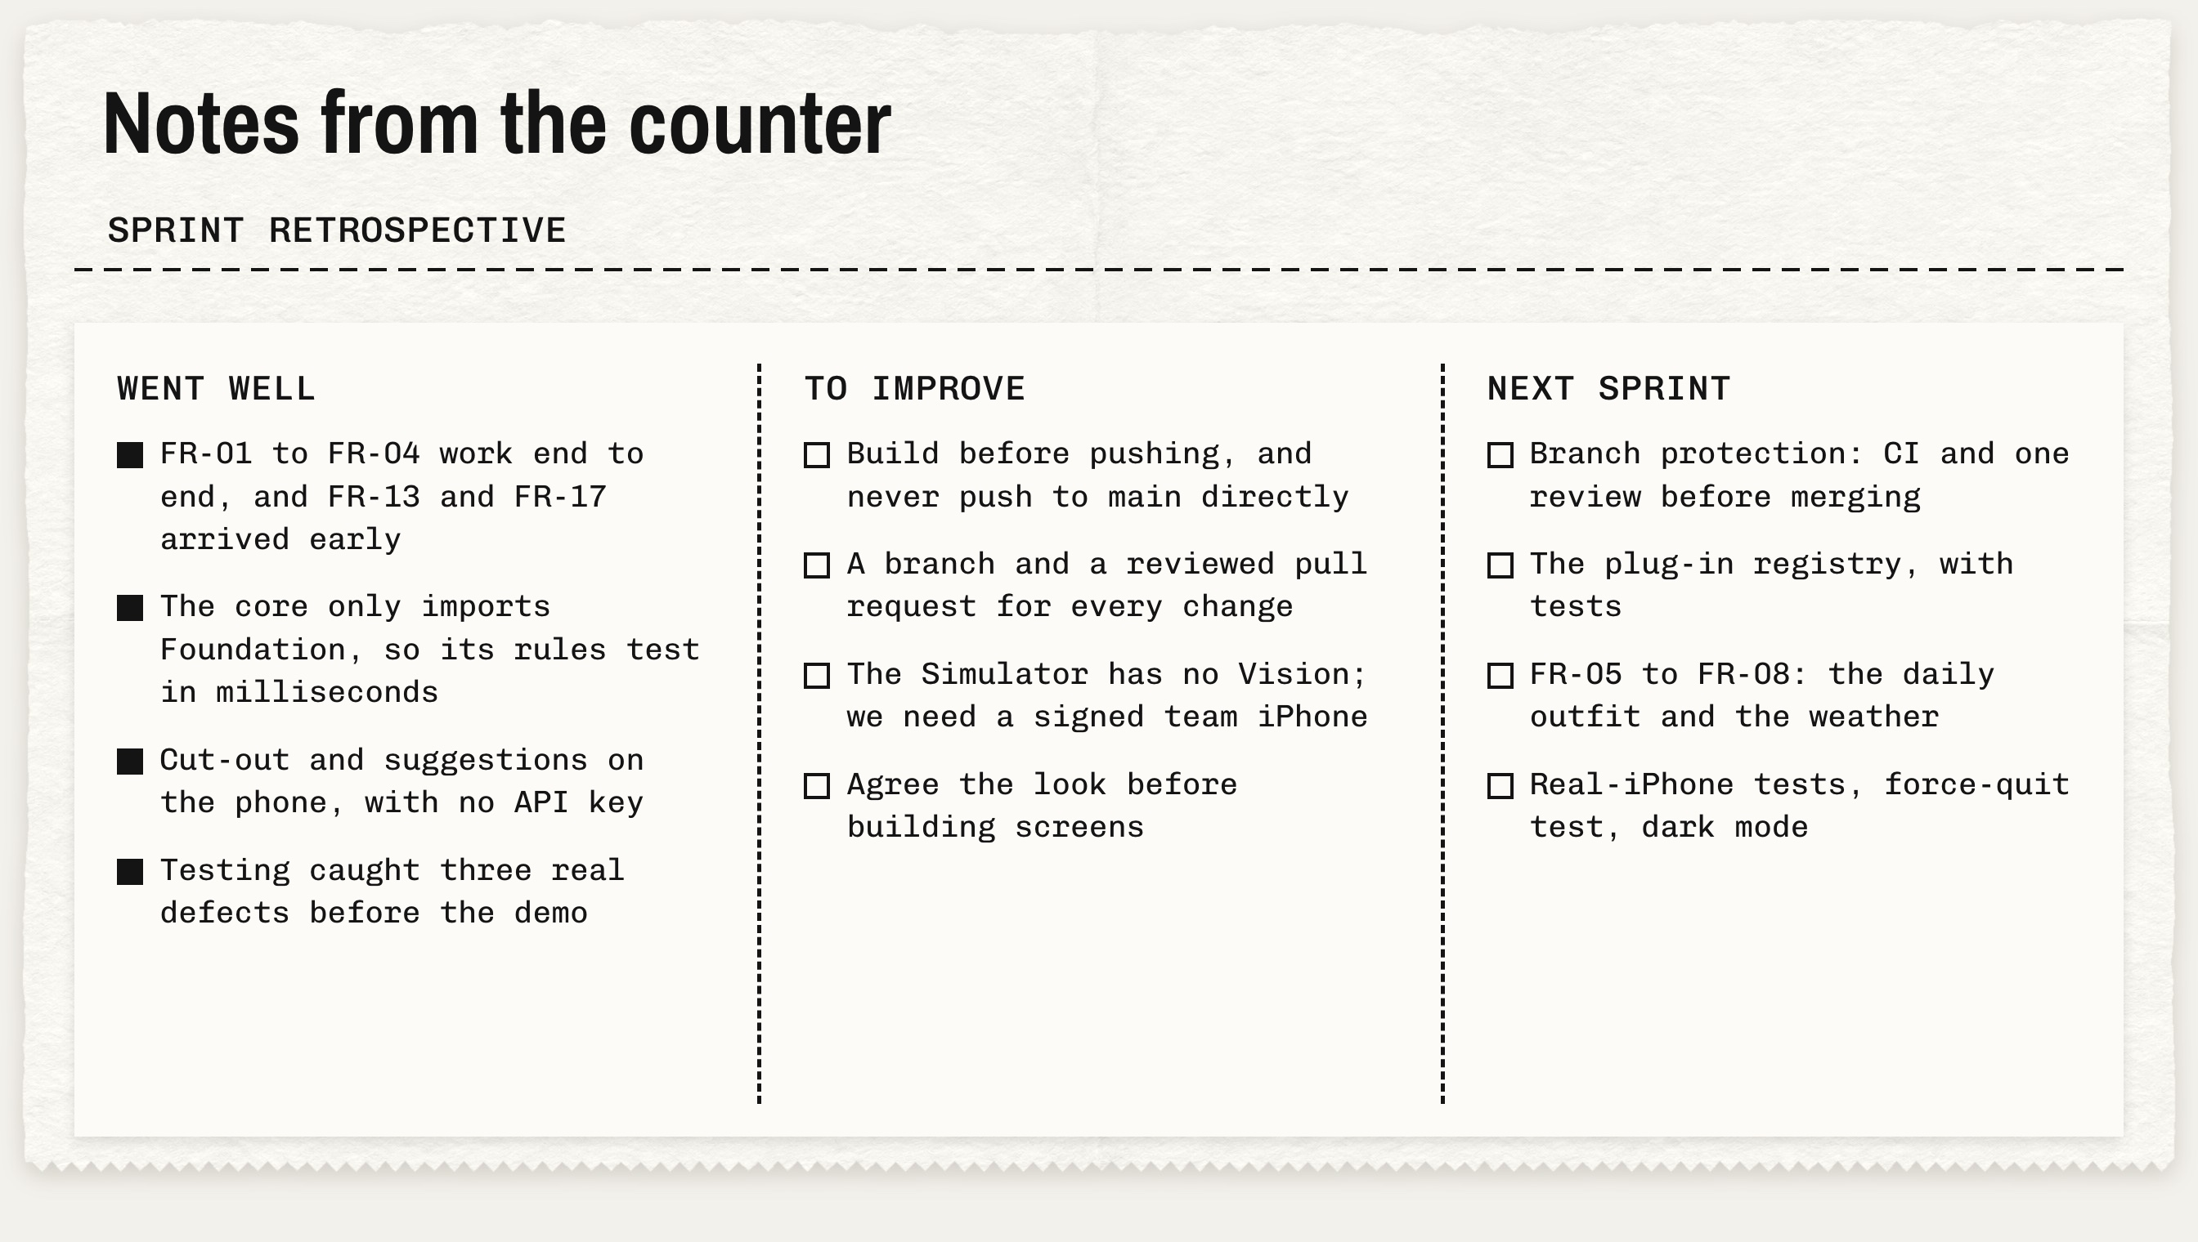
Notes:
What went well, what to improve, and what we change in Sprint 2.

Slide 15
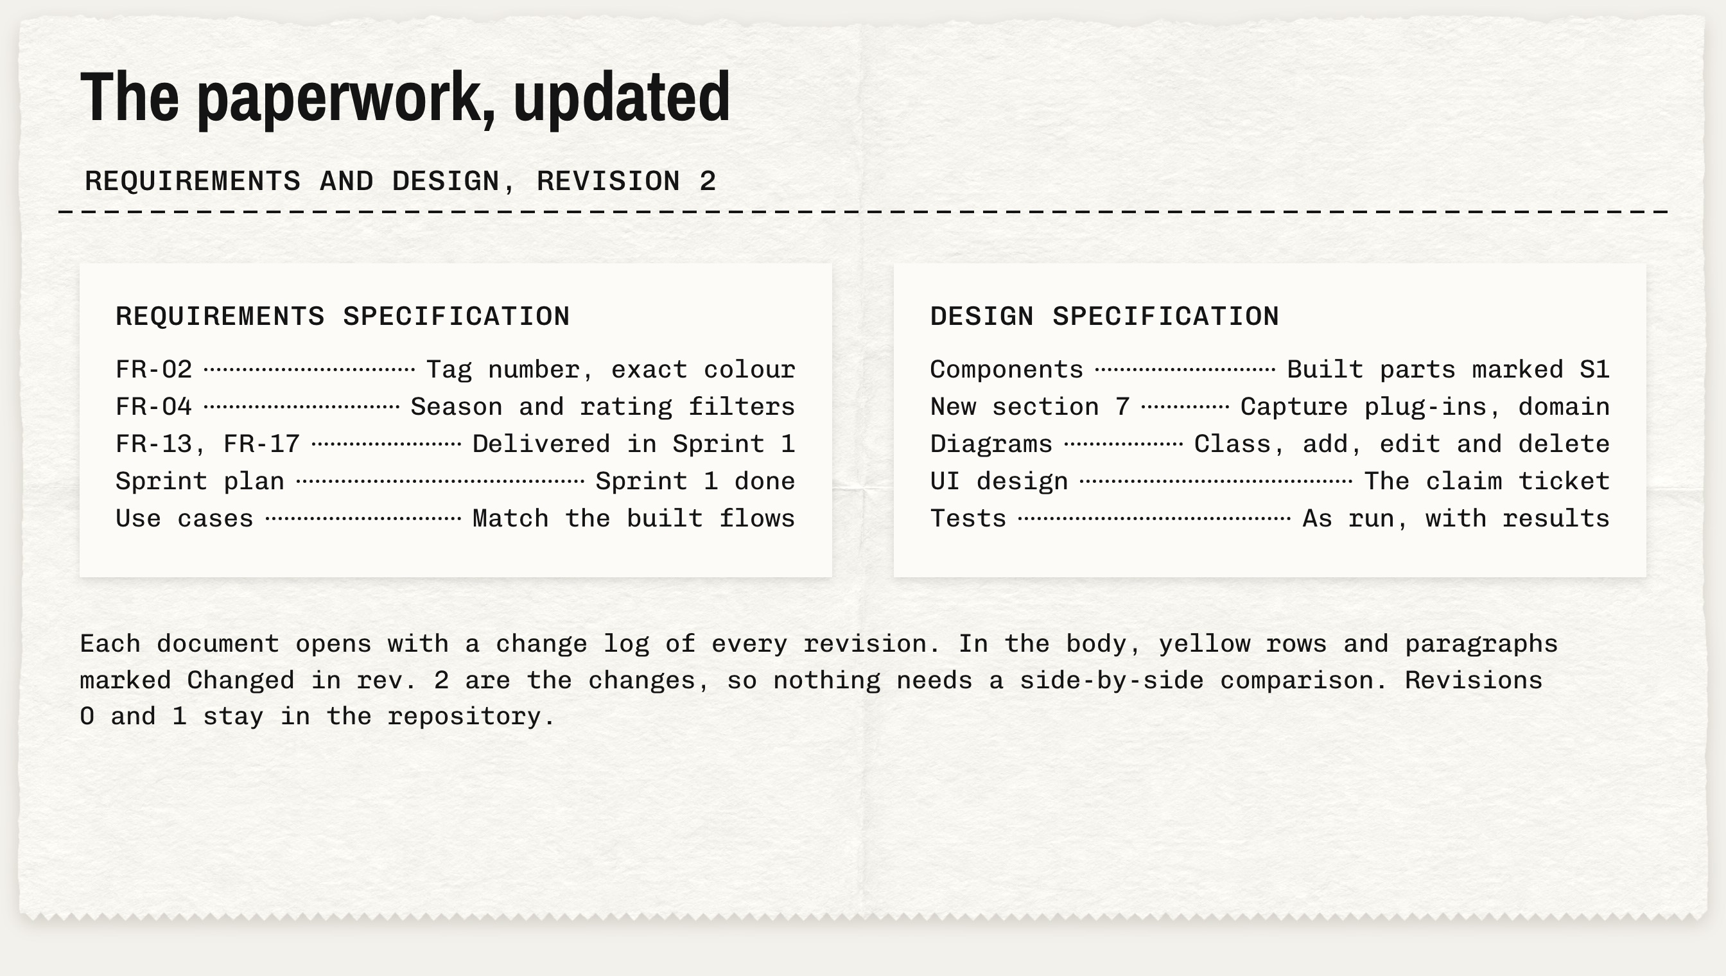
Notes:
Both specifications are at revision 2, with a change log and the changes marked in the body.

Slide 16
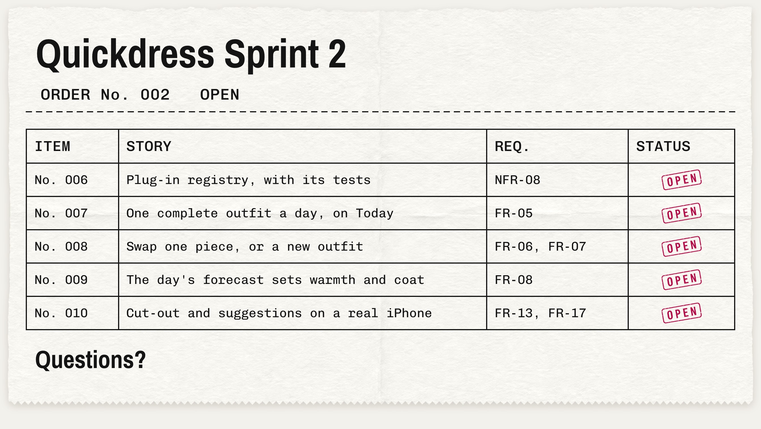
Notes:
Sprint 2 is the outfit itself: the registry, the Today screen, weather and the rule-based recommender. Questions?

